Slide 1
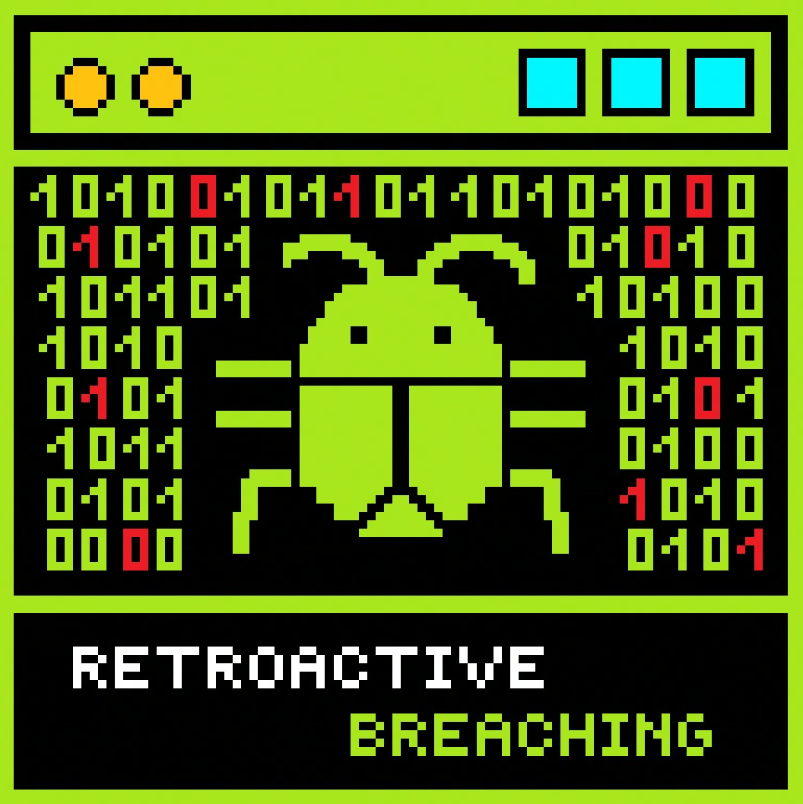
Hoover MaxExtract PressurePro Model 60
Stefanescu Anamaria
Mincic Denis-Mihai
Atodiresei Andrei-Mihai
Szakacs Apor-Tamas
Popescu Lucian
Lengyel Laszlo Levente

Slide 2

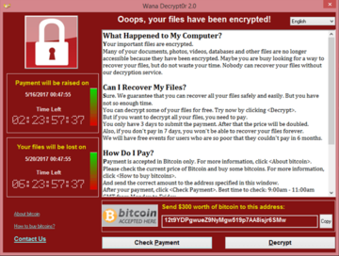
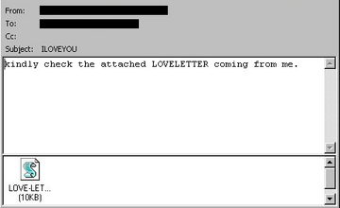
Problem
200,000 computers were infected across 150 countries
Estimated loss of US$4 billion
US$5.5–8.7 billion in damages worldwide
US$10–15 billion to remove the worm

Slide 3
Solution
Awareness
Uniqueness
Monetization
Entertainment/Learning

Slide 4




Framework
Realizarea rapida de prototipe si rezolvare de buguri
Comunitate si integrare
Costuri reduse de dezvoltare

Slide 5



Marketing
Targeted audience
18%
43%
People between the age of 20 and 29
People under 20 years old
23%
People between the age of 30 and 39

Slide 6
Financial Metrics
Base Game Price
20 euros per copy
Estimated copies sold
In first months – between 50.000 and 100.000 copies
Lifetime - 300.000 copies
Retroactive Breaching
Estimated revenue
In first months – 1 mil and 2 mil euros
Lifetime – 6 mil euros

Slide 7


Roadmap
> >
Monetization and microtransactions
Gameplay & story development
Base project finalization
Multiplayer and multiplatform

Slide 8
Q&A

Slide 9
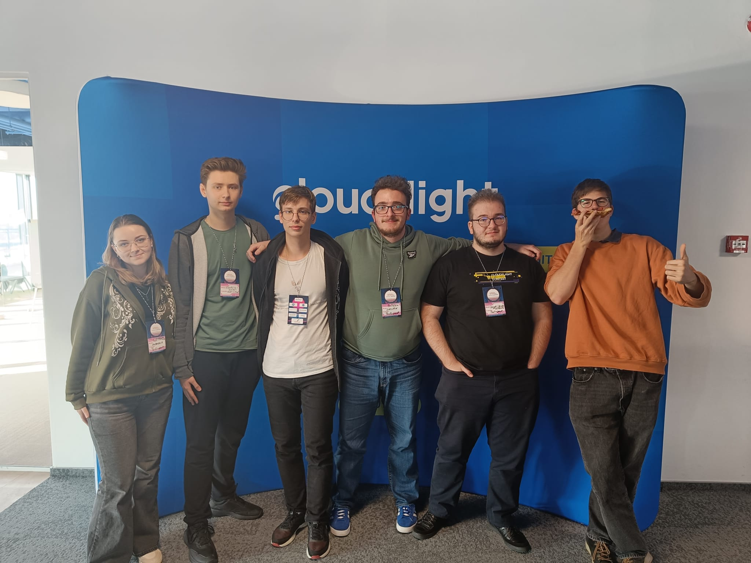
Thanks for your attention!

